Slide 1




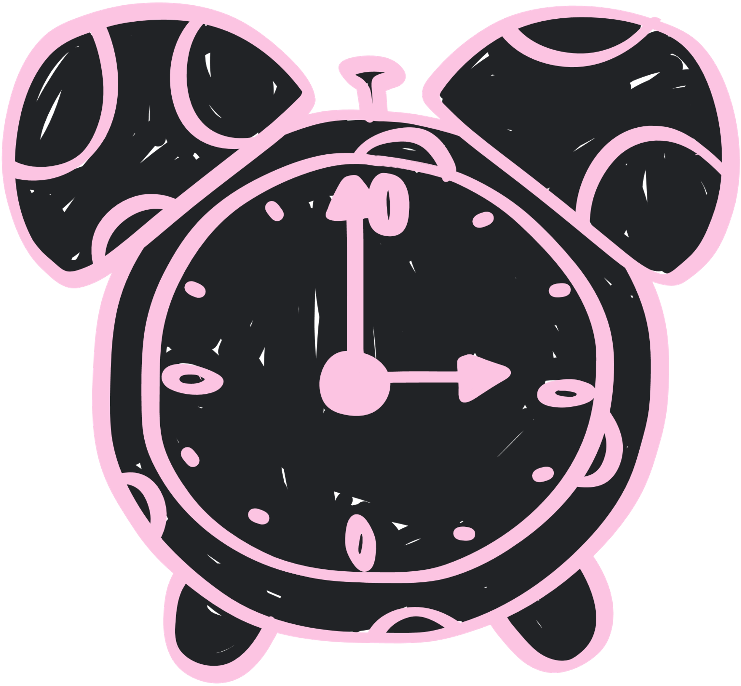

Introduction to Account Policies

Slide 2


TABLE OF CONTENTS
01
Overview Video
04
Conclusion
02
Real World Connections
05
Quiz
03
Mediation
06
Addtl. Resources

Slide 3



Overview Video

Slide 4



Real World Connections
As simple as it is, this stuff really happens!
Ticketmaster (2021)
Routers (2025)
Facebook (2019)
Illegally accessed competitors systems using stolen passwords they learned from a former employee of that rival company. Since they did not change the passwords after that person left, their systems were easily accessible.
A recent study found that 86% of respondents to a survey said that their routers still had their default passwords. This can be dangerous and put you at risk for involuntarily being used for a DDoS attack, a MiTM attack, and or be redirected to a malicious website
Although they claim there was never a breach, Facebook was storing 600 million users information (including passwords) in plaintext (meaning unencrypted) files. Companies should store passwords of users in salted and hash form.

Slide 5



M
Mediation
In a world where passwords hold some of our most private information, they become as valuable as the data they protect. Many methods of protection have been invented over the years to make passwords stronger. The two that we will be examining are the NIST Guidelines as well as Hashing

Slide 6
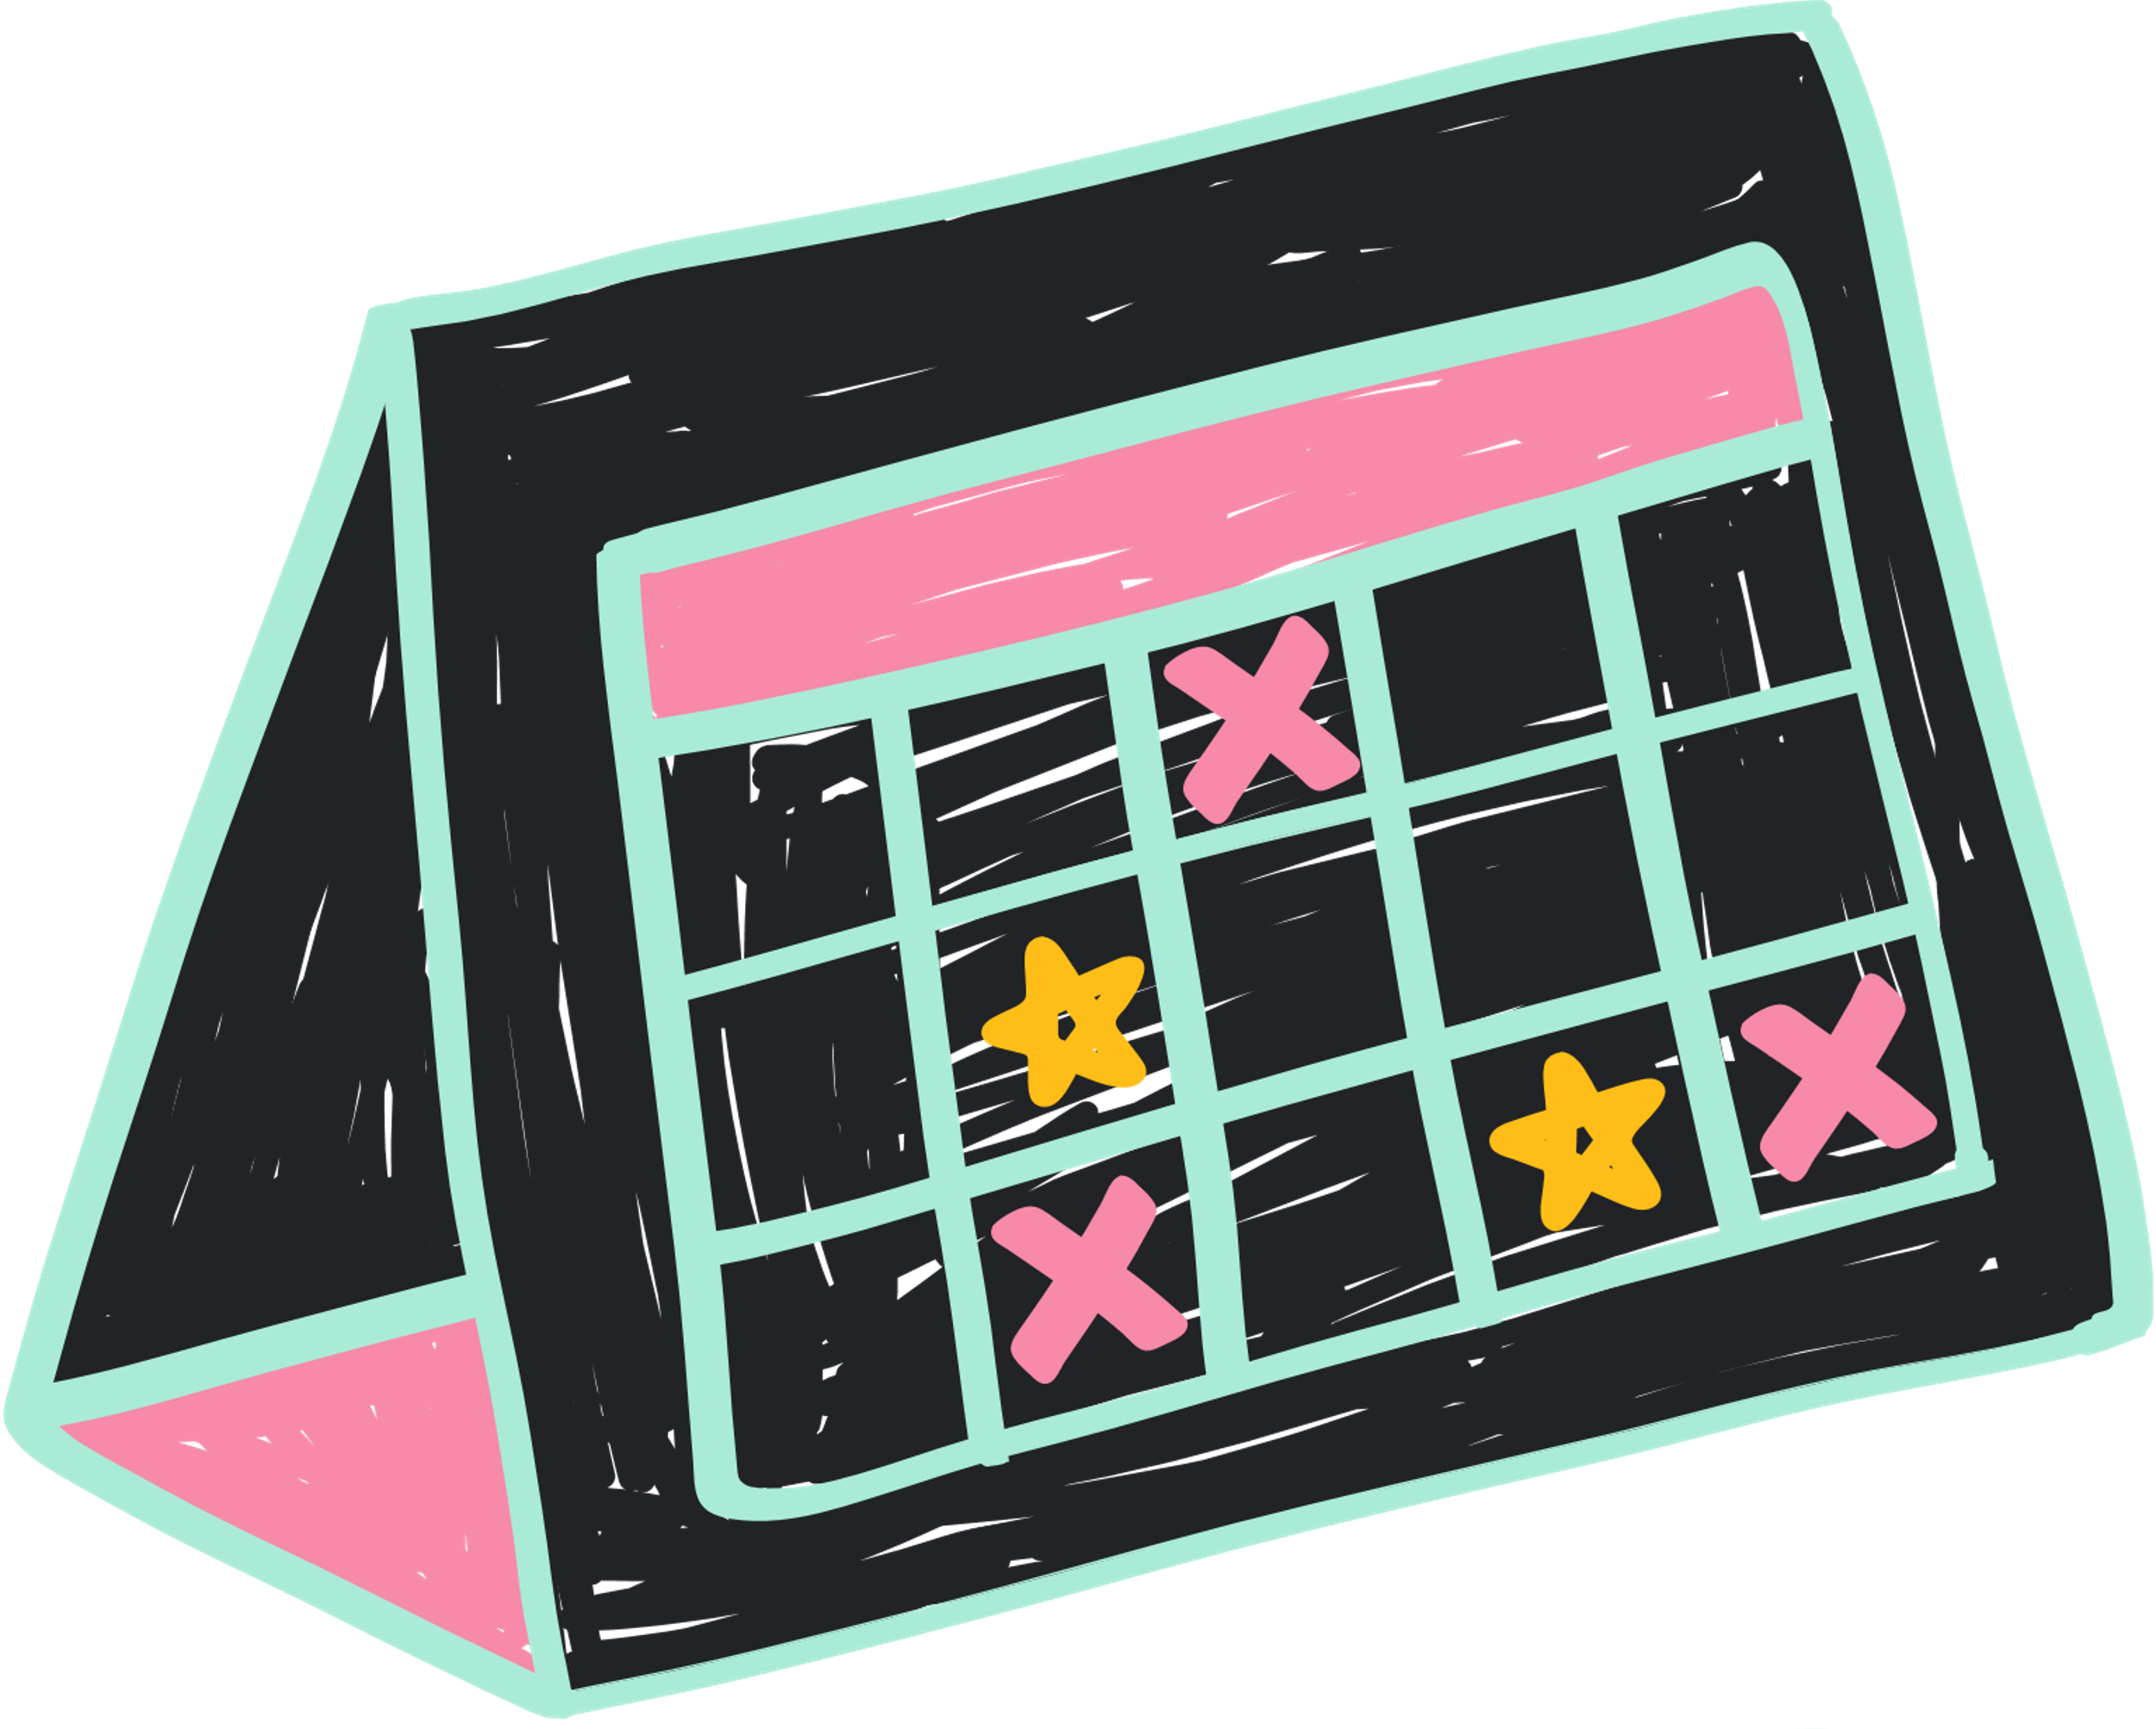
Popular Methods
Hashing
NIST Guidelines
In short, hashing is an algorithm that transforms a user's password into a seemingly random string of characters. Hashes are exceptional passwords because it is practically impossible to reverse the process once a password has been hashed. We can also "salt" a hash, or add a random string of data to the password, making the hash even stronger. Popular hashes are: SHA-256 and SHA-512
National Institute of Standards and Technology
A U.S government agency that develops standards for many aspects of the cybersecurity world (very well known for their password guidelines). The guidelines emphasize password length over complexity, eliminate password expiration, and allow no password hints.

Slide 7
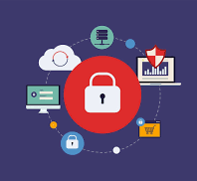
CONCLUSION
We must protect our passwords so that they can properly protect our data. Time and time again, carelessness in password storing and creating has caused millions to have their data leaked. In the next part of this module, you will learn how to use password protection practices to help secure your system in competition.

Slide 8
Quiz!
Keep track of your answers
and review the key at the end!

Slide 9



Question 1
What is an example of a good, secure, hashing algorithm?
MD2
SHA-0
SHA-512

Slide 10
Question 2
What are the NIST Guidelines on Passwords?
Length > Complexity and change password only if compromised
Complexity > Length and frequent password changes
Length > Complexity and frequent password changes

Slide 11
Question 3
What does NIST stand for?
National Institute of Standards and Technology
National Institute of Systems and Teaching
National Institution of Security and Technology

Slide 12
Question 4
How can companies safely store users passwords?
Salting and Hashing
Butter and Salt
Plaintext

Slide 13


Quiz Answers
Question 1
SHA-256 because it is collision resistant and has the snowball effect,
Question 2
Length > Complexity and change password only if compromised
because frequent password changes can lead to people creating guessable passwords (like appending a digit at the end). Long passwords are also harder to guess.
Question 3
National Institute of Standards and Technology
NIST creates the guidelines for Cybersecurity practices.
Question 4
Salting and Hashing keeps passwords safe because it’s a one-way function, irreversible, and it creates unique and random passwords.

Slide 14


Resources
01
CyberChef is an excellent resource for cracking various encryptions as well as hashing your passwords:
https://gchq.github.io/CyberChef/
02
Learn more about NIST and follow along as they update their guidelines every year:
https://linfordco.com/blog/nist-password-policy-guidelines/
03
Curious on if your go-to password has been compromised? Check out this list of 100,000 passwords that have been compromised:
https://www.ncsc.gov.uk/static-assets/documents/PwnedPasswordsTop100k.txt
Notes:
https://haveibeenpwned.com/

Slide 15


THANK
YOU!

